Slide 1
RFID Field strength Measurement Tag
Tijmen Verhulsdonck, Dhananjay Kittur, Binayak Ghosh

Slide 2
Goal of this Project
To create an integrated solution
To measure Field Strength of an RFID reader antenna of any length and width
Present the data in a 4D scattering graph

Slide 3
Description
RFID reader used to power the antenna and generate a field
A start signal is sent to the microcontroller to start sampling the voltages via AM modulation
3D tag, connected to microcontroller, used read voltage values on three axes
Microcontroller reads and processes the measured voltage values
The 3D RF field measurement is plotted to represent the data in four dimension scattered graph

Slide 4
Block Diagram
AM Demodulation
Microcontroller samples voltage values
Send ‘START’ signal
3D Tag
Sends the voltage readings to the software application
Stores voltage readings via voltage divider circuit
Software plots 4d scattered Graph of the measured RF field

Slide 5
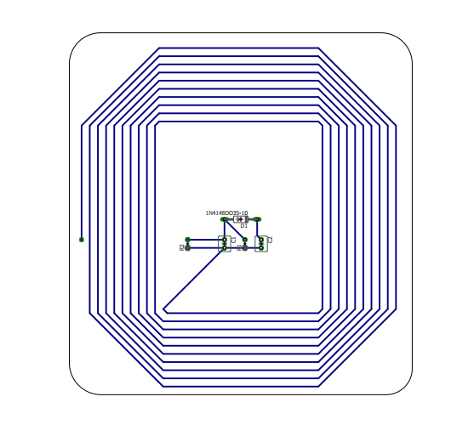
Layout of Tag Antenna

Slide 6
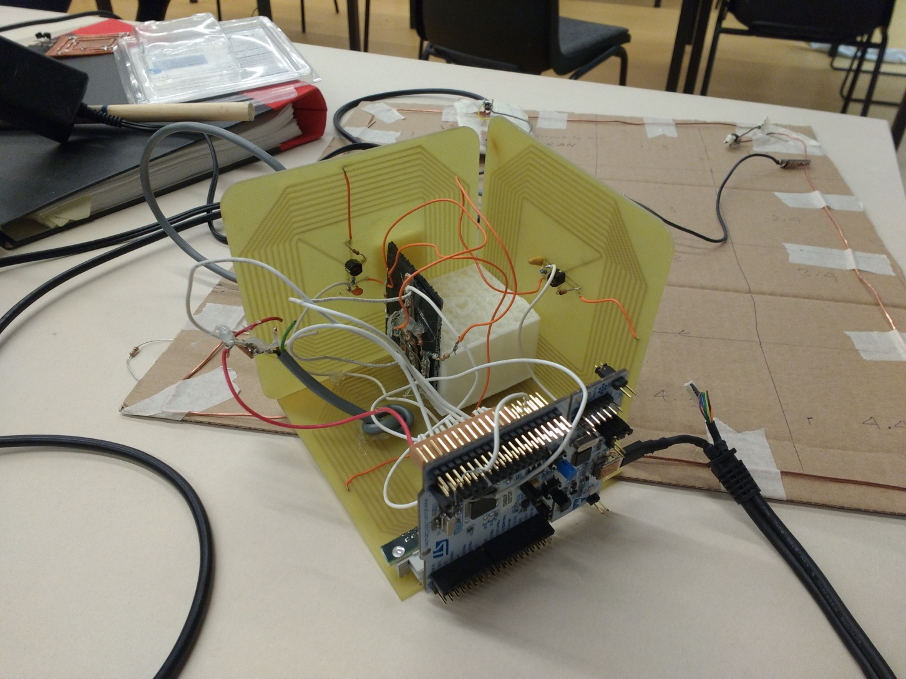
Three Dimensional Tag

Slide 7
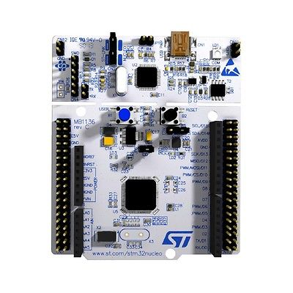
Microcontroller Circuit NucleoSTM32L476RG
A2,A3,A4-Voltmeter
A5-AM Mod

Slide 8
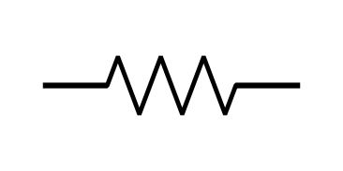
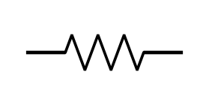

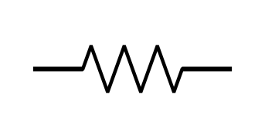
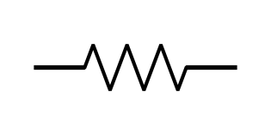

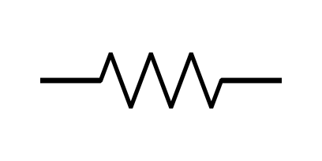
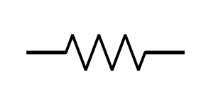

Voltage Divider Circuit
V_O1
R1
R2
V_XY
V_O2
R1
R2
V_YZ
V_O3
R1
R2
V_ZX

Slide 9
AM Demodulation Circuit

Slide 10
Sampled Voltage Readings
For 2mm
X-Axis Z-Axis
34.6000 34.9000 32.8000 40.6000 0.3598 0.0417 0.2348 1.0000
36.1000 31.9000 33.7000 45.9000 0.5644 0.0947 0.1515 0.7348
32.3000 32.9000 33.3000 38.9000 0.6367 0.1553 0.0386 0.6614
21.3000 40.2000 32.4000 41.2000 0.4561 0.2462 0.0606 0.3428
Y-Axis
0.7538 0.7603 0.7146 0.8845
0.7865 0.6950 0.7342 1.0000
0.7037 0.7168 0.7255 0.8475
0.4641 0.8758 0.7059 0.8976

Slide 11
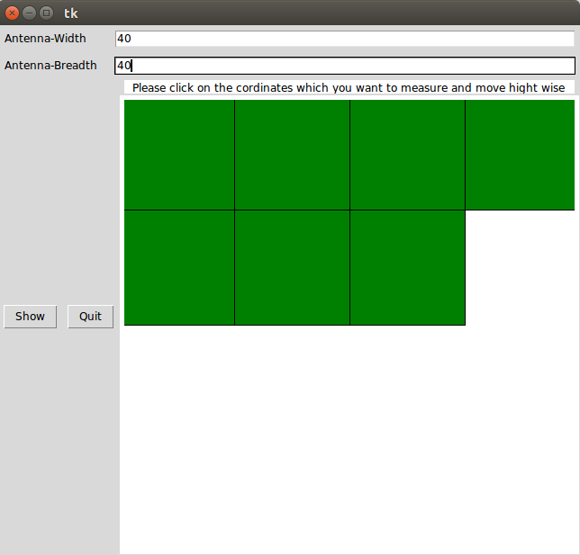
Graphical User Interface

Slide 12
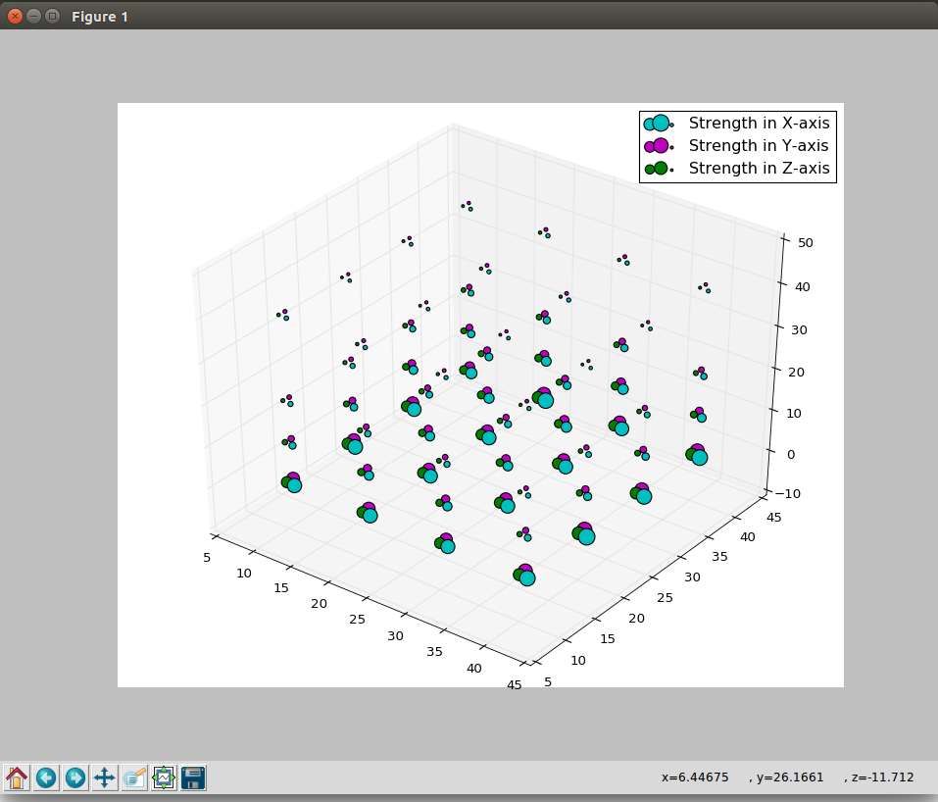
4-Dimensional Scattered Graph

Slide 13
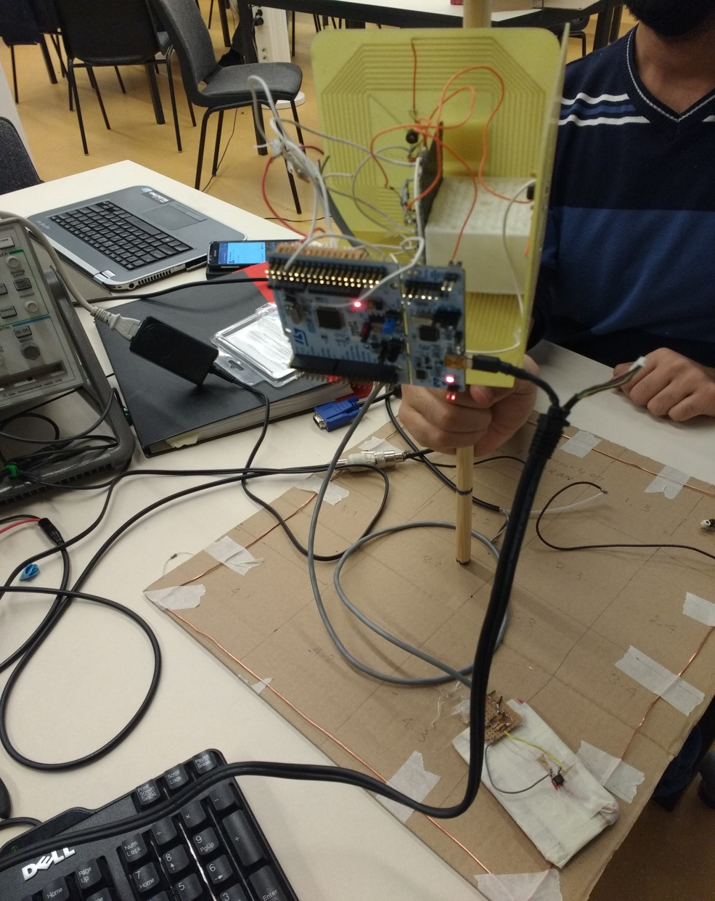
Final Prototype

Slide 14
THANK YOU

